Slide 1
Ingest Data with Dataflows Gen2 in Microsoft Fabric
Module 8

Slide 2
What are dataflows?
Self-service, cloud-based, data preparation
Ingest and transform data, land in a destination
Can be scheduled directly or by calling from a pipeline
Power Query Online
Promote reusable ETL logic that prevents the need to create more connections to your data source
Notes:
Dataflows are a self-service, cloud-based, data preparation technology. They are used to ingest and transform data from multiple sources, and then land the cleansed data to another destination. They can be incorporated into data pipelines for additional data movement, and used as a data source in Power BI.
They can be standalone or incorporated into a data factory pipeline.

Slide 3
Benefits of Dataflows
Allow self-service users access to a subset of data warehouse separately
Reduce number of time data is extracted from a source
Simplify data source complexity
Simplify data integration by providing a low-code interface
Notes:
There's more than one way to ETL or ELT data in Microsoft Fabric. Consider the benefits and limitations for using Dataflows (Gen2).
Benefits:
Extend data with consistent data, such as a standard date dimension table.
Allow self-service users access to a subset of data warehouse separately.
Optimize performance with dataflows, which enable extracting data once for reuse, reducing data refresh time for slower sources.
Simplify data source complexity by only exposing dataflows to larger analyst groups.
Ensure consistency and quality of data by enabling users to clean and transform data before loading it to a destination.
Simplify data integration by providing a low-code interface that ingests data from various sources.
While there are many benefits, there are occasions as discussed in previous modules where a notebook or a pipeline would perform better or offer additional functionality. And dataflows are not a replacement for a data warehouse. It’s important to note that dataflows do not support row-level security.

Slide 4
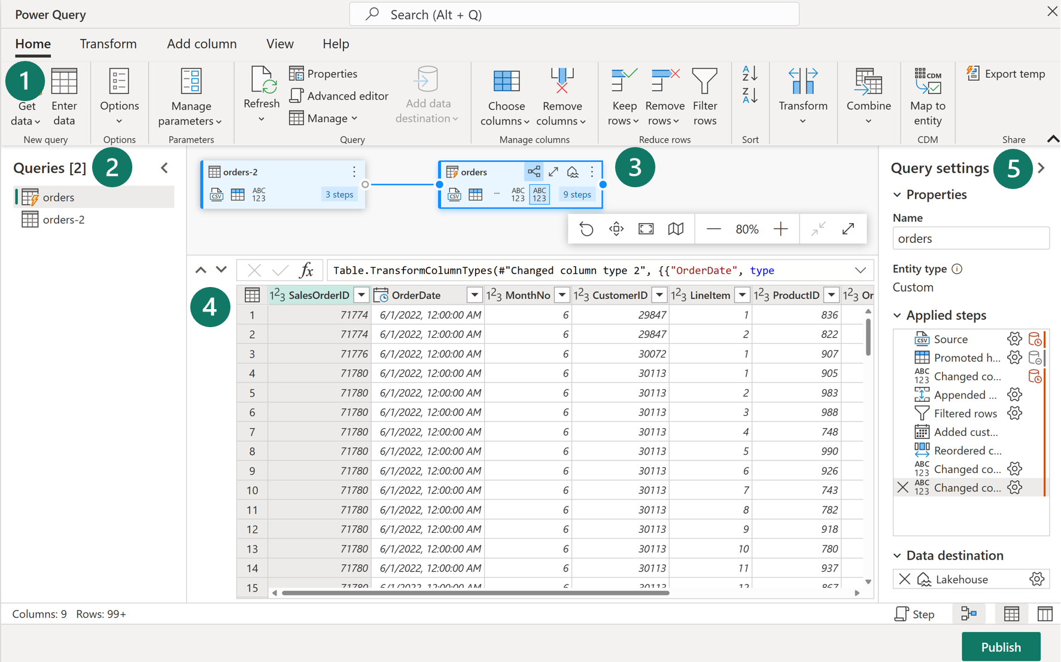
Power Query Online
Notes:
When working with dataflows in Power Query Online, there are 5 main areas to work with in the browser window.
Power Query ribbon grants access to get data from various sources and transform it using a GUI.
The Queries pane shows you the different data sources - now called queries. Rename, duplicate, reference, and enable load are some of the options available.
The Diagram View allows you to visually see how the data sources are connected and the different applied transformations.
The Data Preview pane only shows a subset of data to allow you to see which transformations you should make and how they affect the data. You can also interact with the preview pane by dragging and dropping columns to change order or right-clicking on columns to filter or make changes.
The Query Settings pane primarily includes Applied Steps. Each transformation you do is tied to a step, some of which are automatically applied when you connect the data source. Depending on the complexity of the transformations, you may have several applied steps for each query.

Slide 5
What can you do with a dataflow?
Ingest data from a source
Output data to a destination
Add a custom column
Change data types
Group/summarize rows
Merge tables
Parse JSON files
And more!
Notes:
Fundamentally, a dataflow includes all of the transformations to reduce data prep time and then can be loaded into a new table, included in a Data Pipeline, or used as a data source by data analysts.
You can connect to data sources inside or outside of Fabric, output the data to destinations such as your data warehouse or lakehouse. Adding a data destination to your dataflow is optional, and the dataflow preserves all transformation steps. To perform other tasks or load data to a different destination after transformation, create a Data Pipeline and add the Dataflow (Gen2) activity to your orchestration.

Slide 6
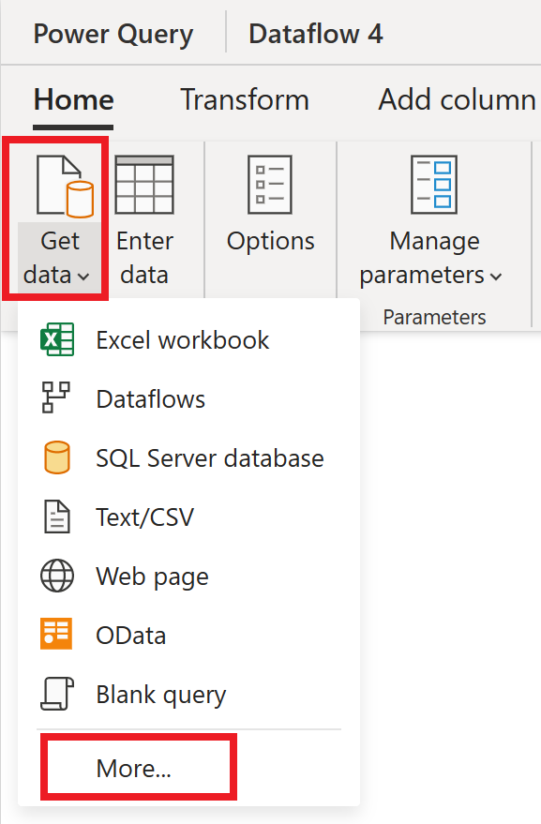
Get Data
Establish the source of your data
Choose from several dozen sources
Sources can be internal or external to Fabric
Notes:
The Get Data experience allows you to choose a source from several options. These options can be inside your Fabric tenant, in Azure or Power Platform, public web pages, or on premises.

Slide 7
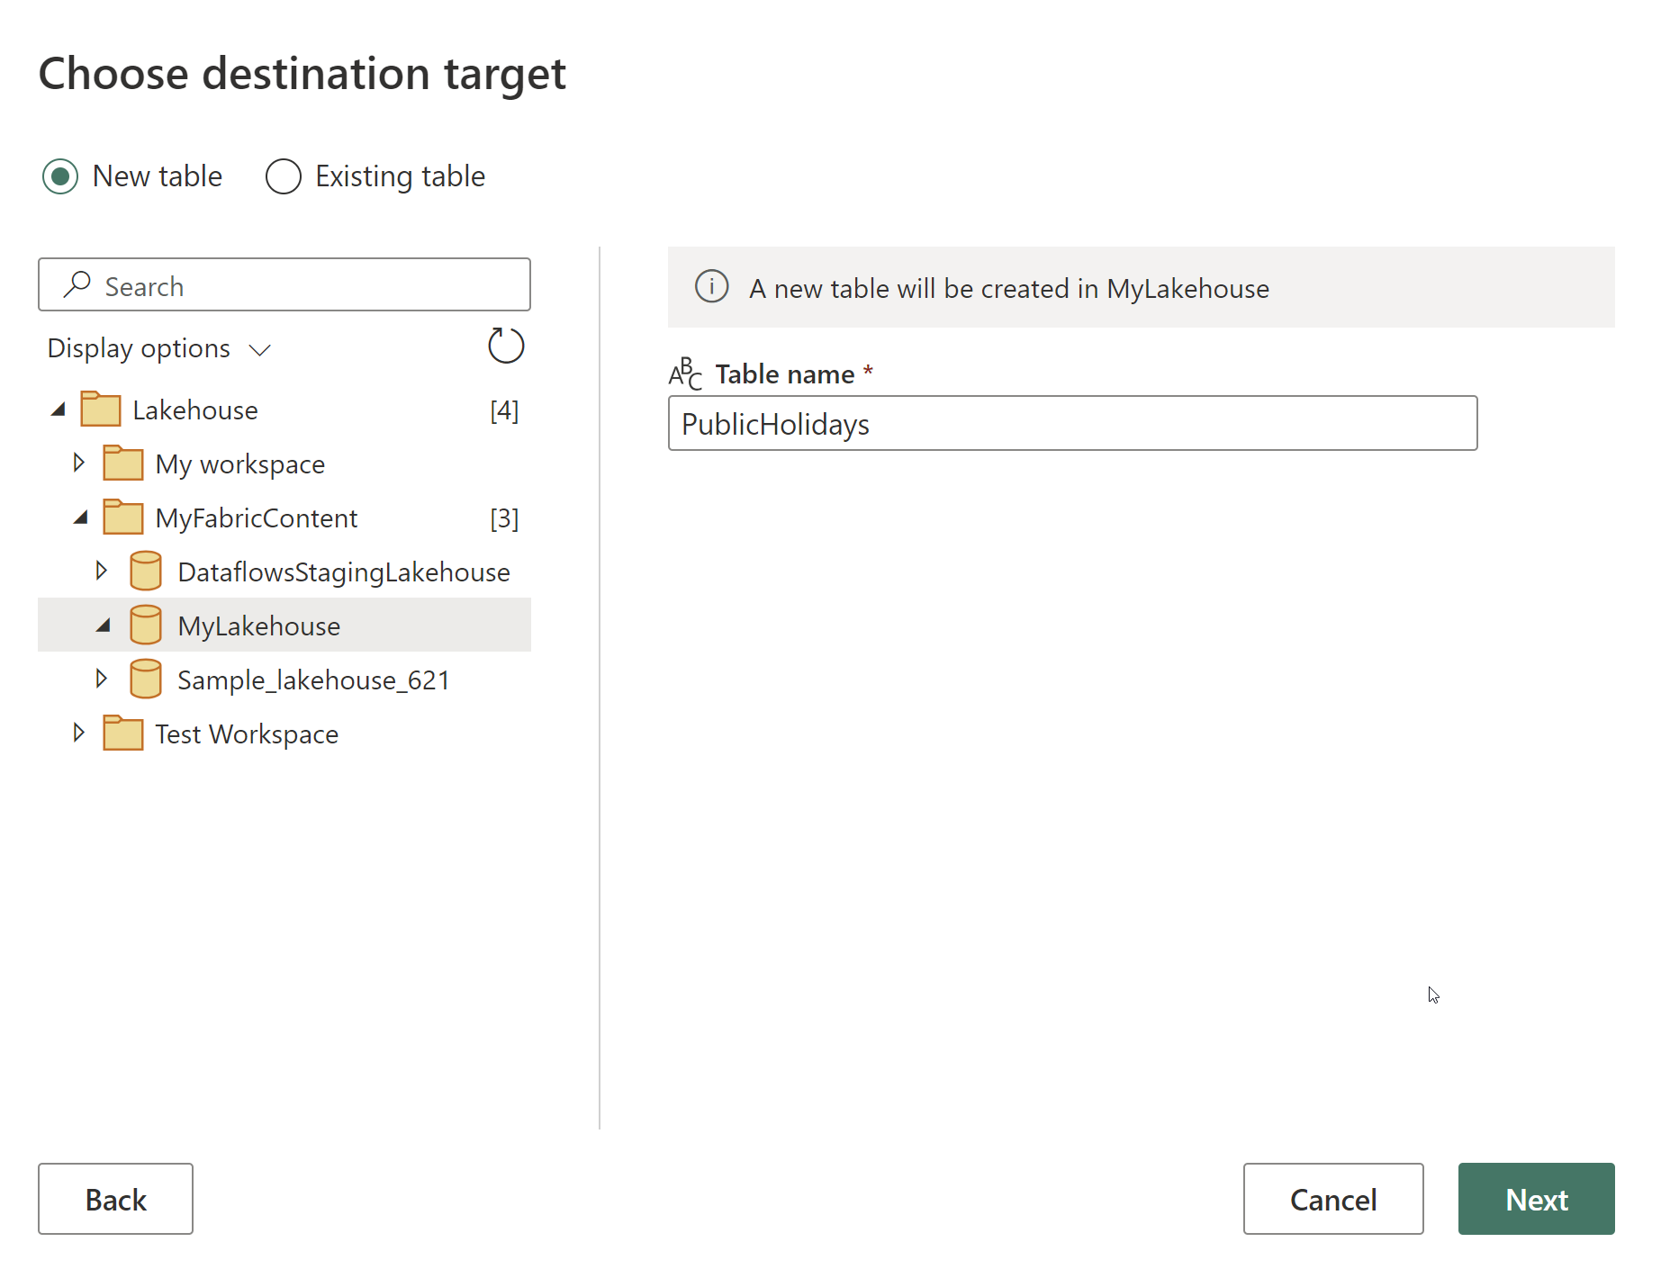
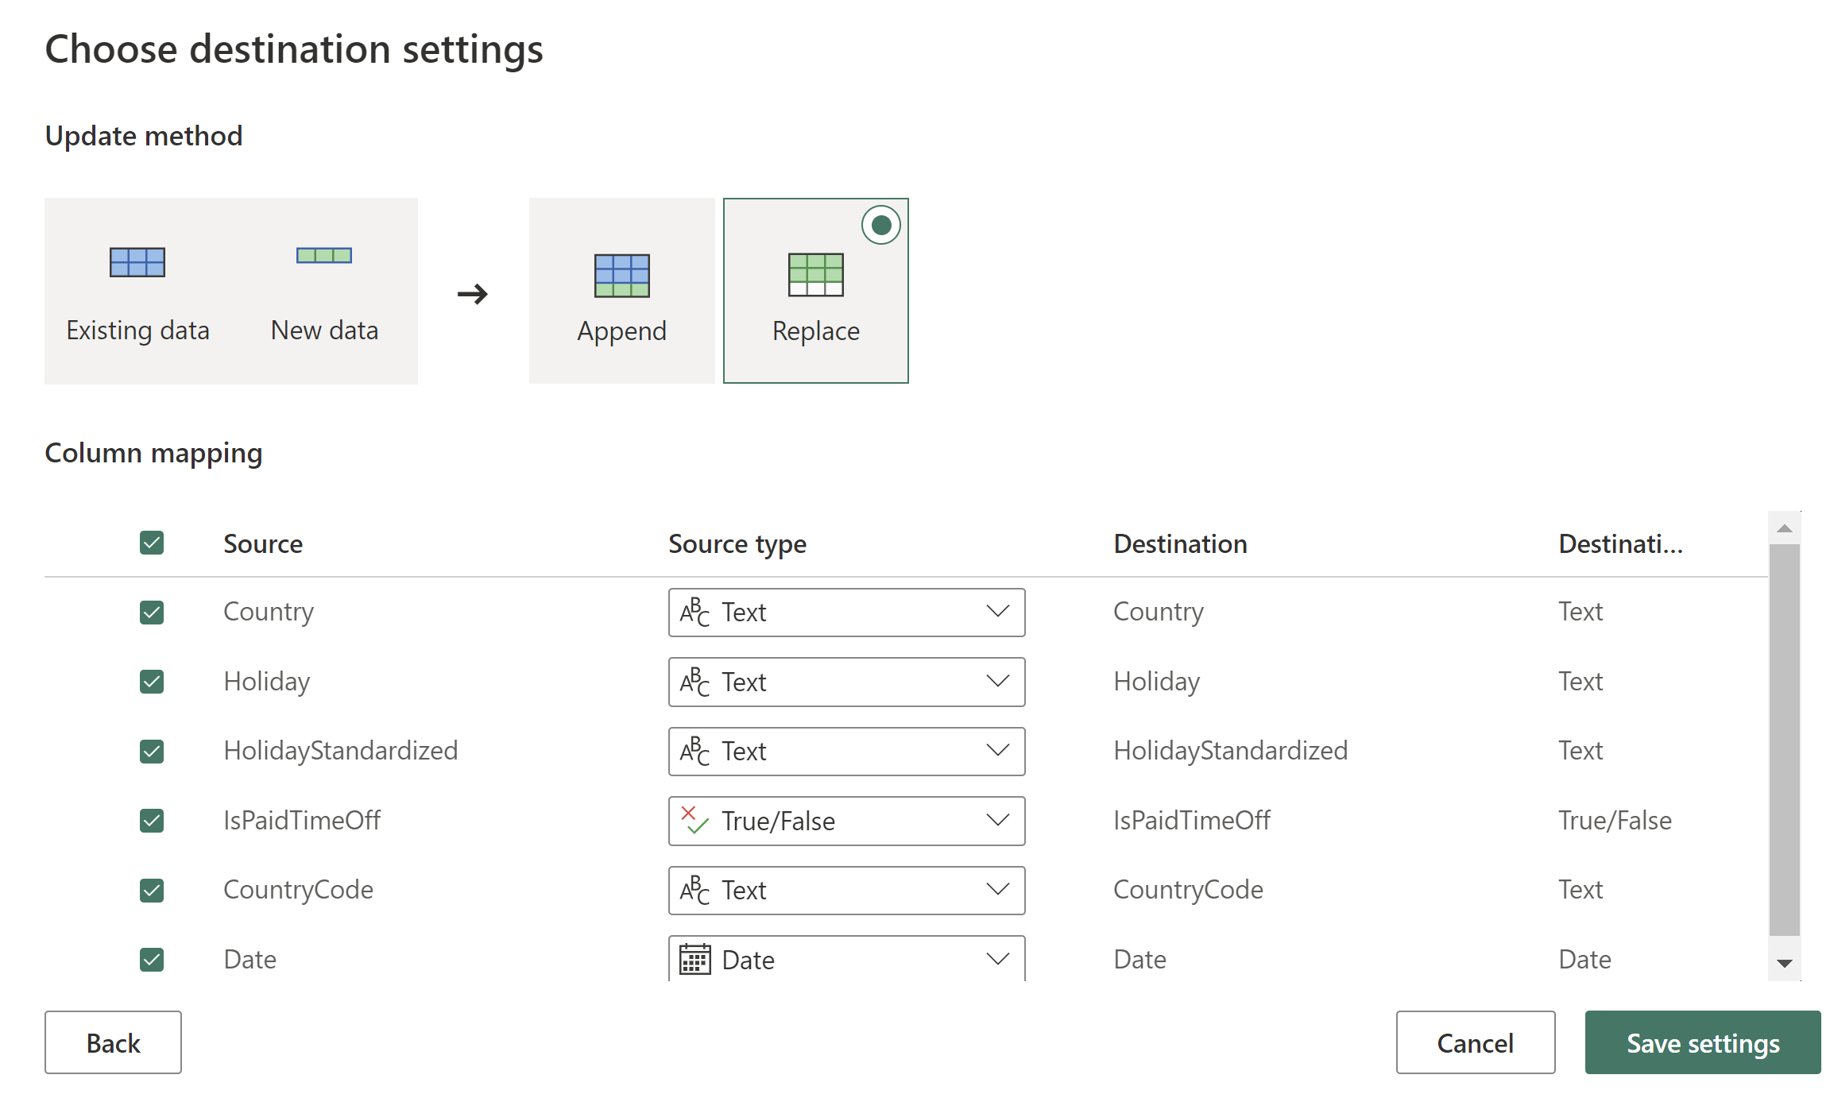
Destination
Notes:
When selecting your destination, you can choose from available items in Fabric. You can have the dataflow create a new table or choose and existing table.
Next, you can choose the update method, indicating whether you want to append data or replace data. And then configure the column mapping.

Slide 8
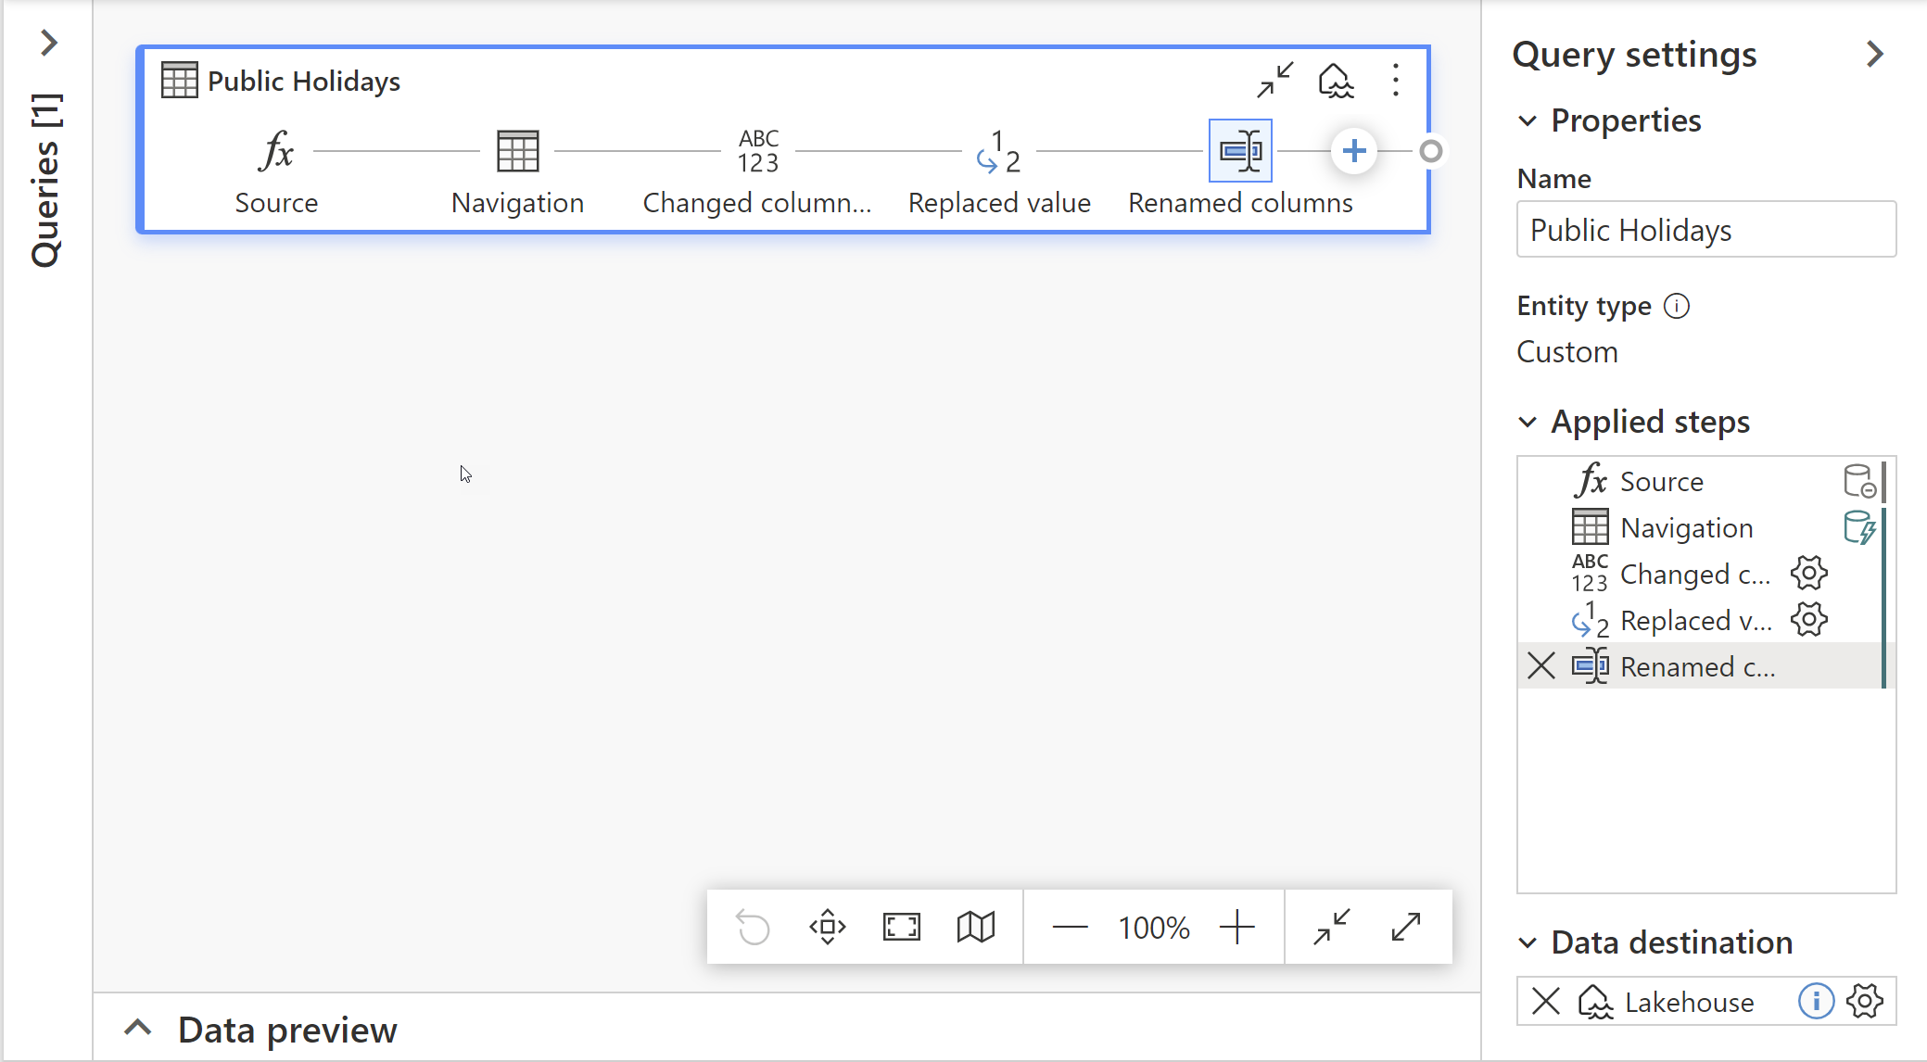
Dataflow Transformation Example
Source: Table in Lakehouse A
Change column data type
Replace missing/invalid values
Rename columns
Destination: Table in Lakehouse B
Notes:
As a simple example, there is a table in Lakehouse A called Public holidays. We want to reuse this data, but we want to clean it up a bit before we can use it. So we choose the source table in Lakehouse A. We change a datetime column to date. We replaced some null values in a true/false (bit) field with false values.
We renamed columns to follow our destination lakehouse naming convention. And finally, we land the data in Lakehouse B.

Slide 9
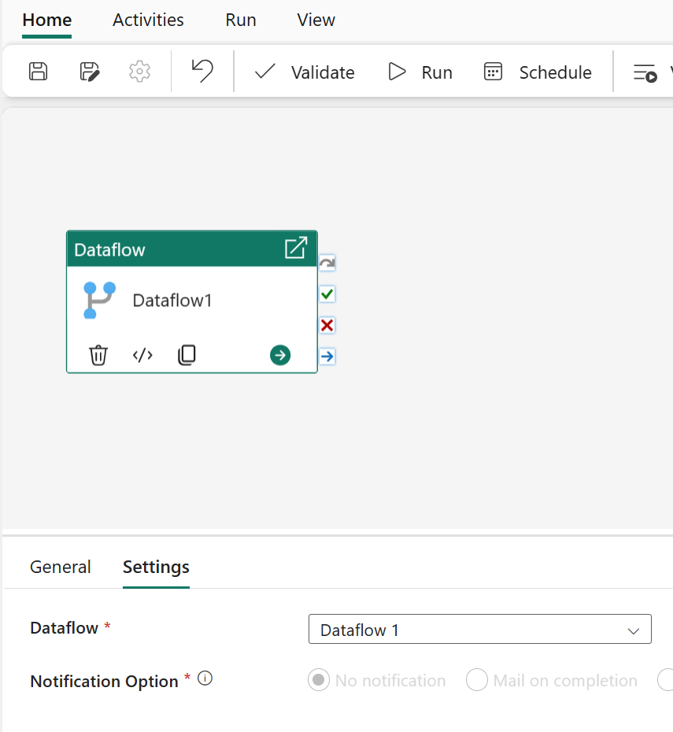
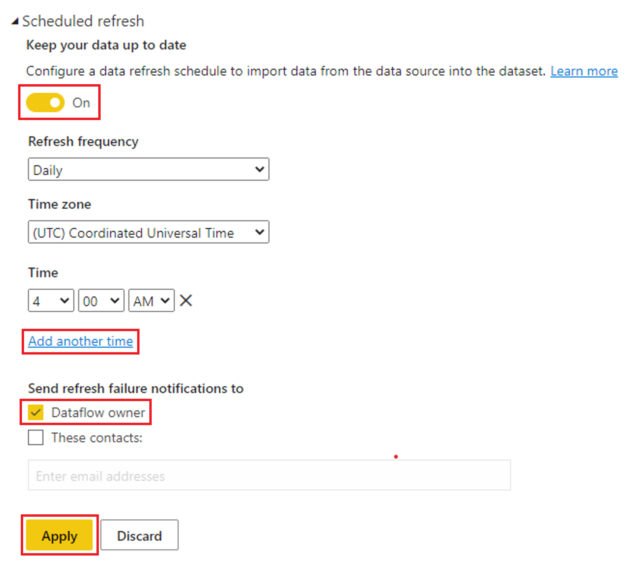
Scheduling Dataflows
Notes:
Recall that you have two options for scheduling a dataflow: 1) You can add it to a pipeline and then schedule the pipeline or 2) You can schedule it directly.
If this dataflow has dependencies on other pipelines or is part of a larger enterprise orchestration flow, it should be added to a pipeline. If it has no upstream dependencies, you can schedule it directly.
For example, let’s say you load data to a lakehouse using a copy activity in a pipeline, then you use a dataflow to transform the data into final reporting tables in the lakehouse. You can chain these activities together using pipelines.
If you aren’t waiting on some data to be loaded, say you are directly accessing the data source with a dataflow or it’s fine to take whatever data is in your lake at the time the dataflow runs, you could schedule directly. So, your decision is based upon both business requirements and comfort with the technologies.

Slide 10
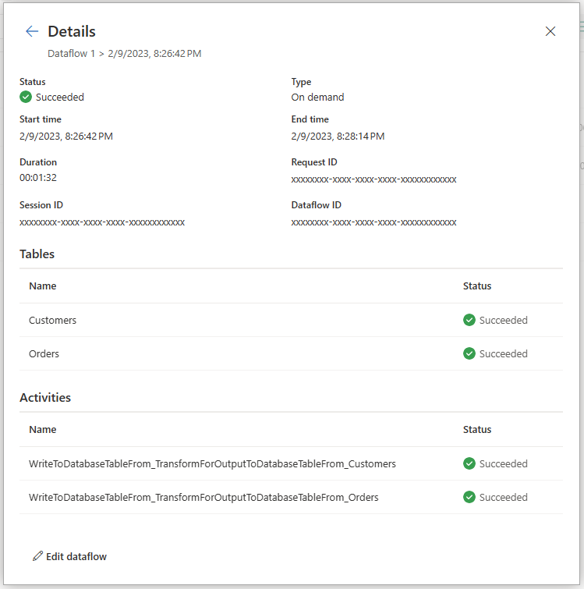
Dataflow Refresh History
Notes:
Monitoring your dataflow refreshes is key in ensuring that your dataflows are running as expected. Refresh history and monitoring hub allows you to evaluate in detail what happened during the refresh of your dataflow.
When you open your dataflow refresh history, you first notice a list of all your data refreshes. This first screen provides you with information about:
Start time
Status
Duration
Type
You can take some actions right away from this page like start a new refresh, schedule a refresh, or edit the dataflow. Once you've determined which dataflow you want to investigate, you can drill down into one of the refreshes by selecting the Start time field. This screen provides you with more information about the refresh that was performed. This includes general information about the refresh and a list of tables and activities.
this overview provides you:
Status of the dataflow
Type of refresh
Start and End time
Duration
Request ID
Session ID
Dataflow ID
The Tables section reflects all the entities you've enabled load for in your dataflow. Meaning that those tables shown here are being loaded into the staging area of your dataflow.
The Activities section reflects all the actions that have taken place during the refresh, for example loading data to your output destination. This table also allows you to dive deeper into the details of the specific activity.

Slide 11
Summary
Dataflows offer low-code self-service data preparation by using Power Query Online
Dataflows can be scheduled directly or called from a pipeline
Dataflow refresh history shows status, duration, type, and a breakdown of each table and activity
Notes:
The Power Query Online user interface allows us to do anything from simple ingestion to complex transformation in a dataflow. We can schedule our dataflow directly or via a pipeline. Once that dataflow has been executed, we can review the refresh history to see the status, duration, and type of execution.

Slide 12

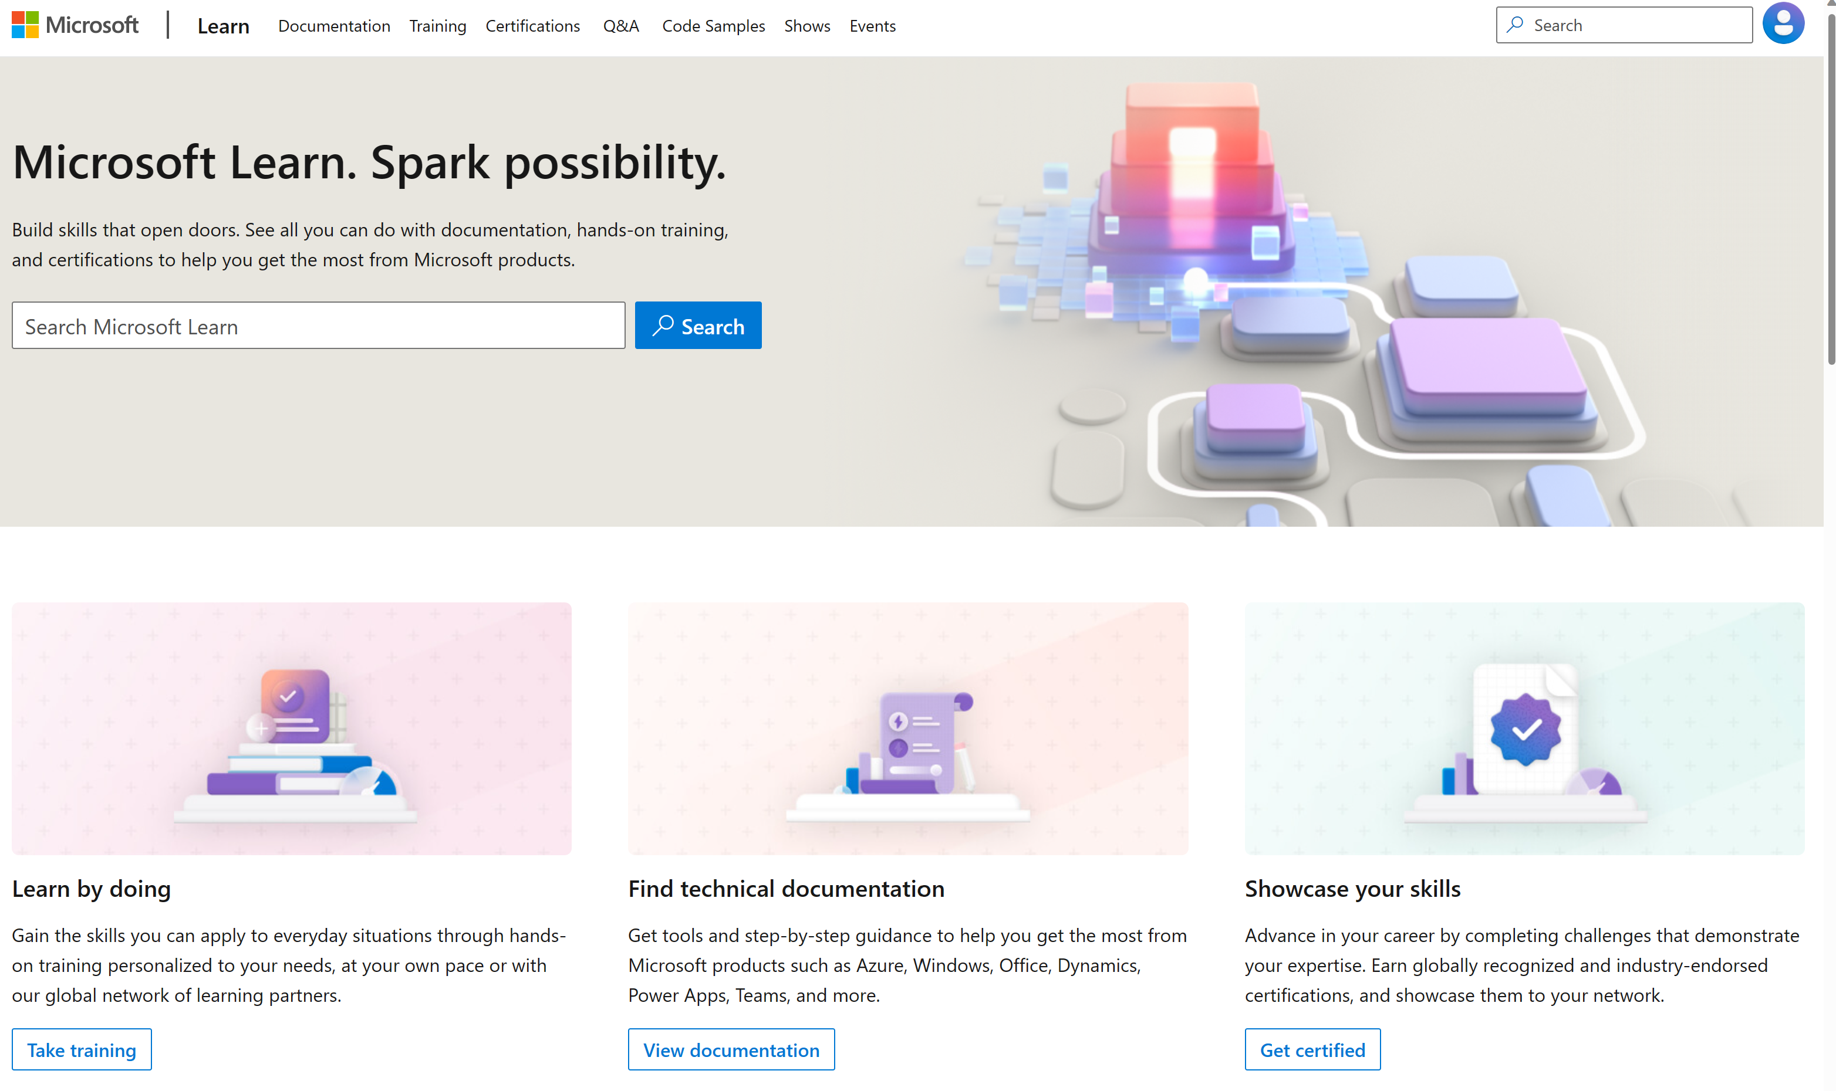
Microsoft Learn Demo
Microsoft Learn: Build skills that open doors in your career

Slide 13
Readiness and Enablement Links
The Microsoft Federal Team is here to help you accelerate customers' digital transformation. Microsoft Federal has tailored to make your organizations skilling journey successful. From the Business Decision Maker to the technical community and end-users, Microsoft provides customers with access to endless skilling resources. Below you will find links to these resources:
Get training tailored to your organization's needs: Find learning paths for specific roles in your organization, plus course recommendations based on technology, skill level, and solution area: Training | Learning Portal (microsoft.com)
Events Calendar - US Partner Community Blog – Microsoft
In addition to the above, the Microsoft Federal Team can address the needs of your non-technical community of your learners through:
Skilling Hours - Readiness and Enablement: Skilling our Federal Customers and Partners (office.com)
Microsoft Learning Portal: A closer look at Azure through training modules and gamified learning
Microsoft Learning Portal
Additional Learning Resources:
Get started with Azure – Introduction | Microsoft Azure
Microsoft Learn (path-based)
Exam-based: Select filters: Azure, D365, M365, Power Platform, and more
Microsoft Virtual Training Days – Virtual Instructor Led
Microsoft Technology Center - Work through your Account Manager
Home - Microsoft Tech Community
Microsoft Reactor | Microsoft Developer – Virtual Instructor Led

